Slide 1
AUTOMATIC PLANT WATERING SYSTEM
JUNE 2ND
Nguyen Xuan Hao
02 / 06 / 2023

Slide 2

INTRODUCTION

Slide 3

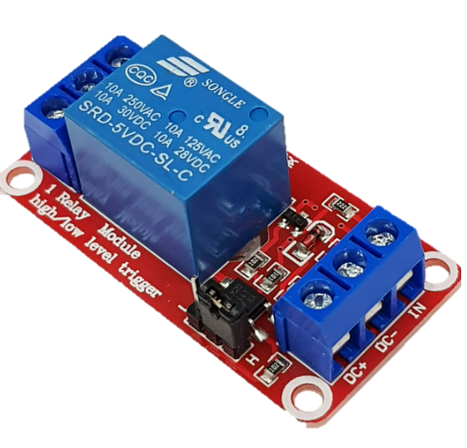
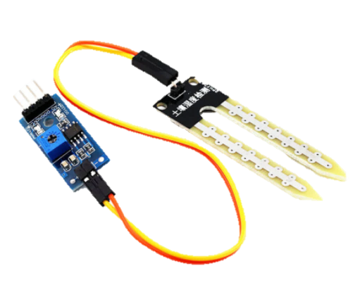
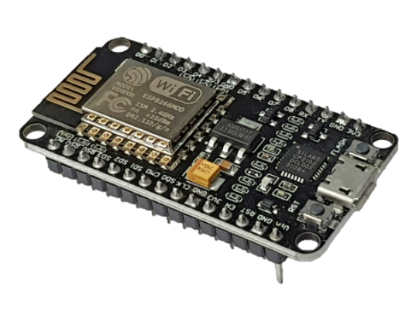
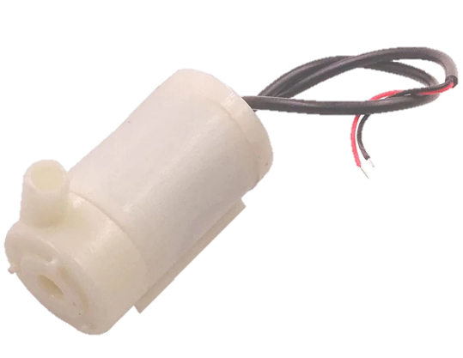
COMPONENTS & CIRCUIT
Soil moisture value measured
Send value of moisture to application and collect data from application
Module Relay
Relay module to control the pump.
Wifi ESP8266 NodeMCU
Moisture Sensor Module
Check if the soil moisture value is smaller than 30% and button on the application is pressed
Mini Submersible Water Pump
Use dirt moisture sensor to measure soil moisture.
Pump the water for watering the plant

Slide 4
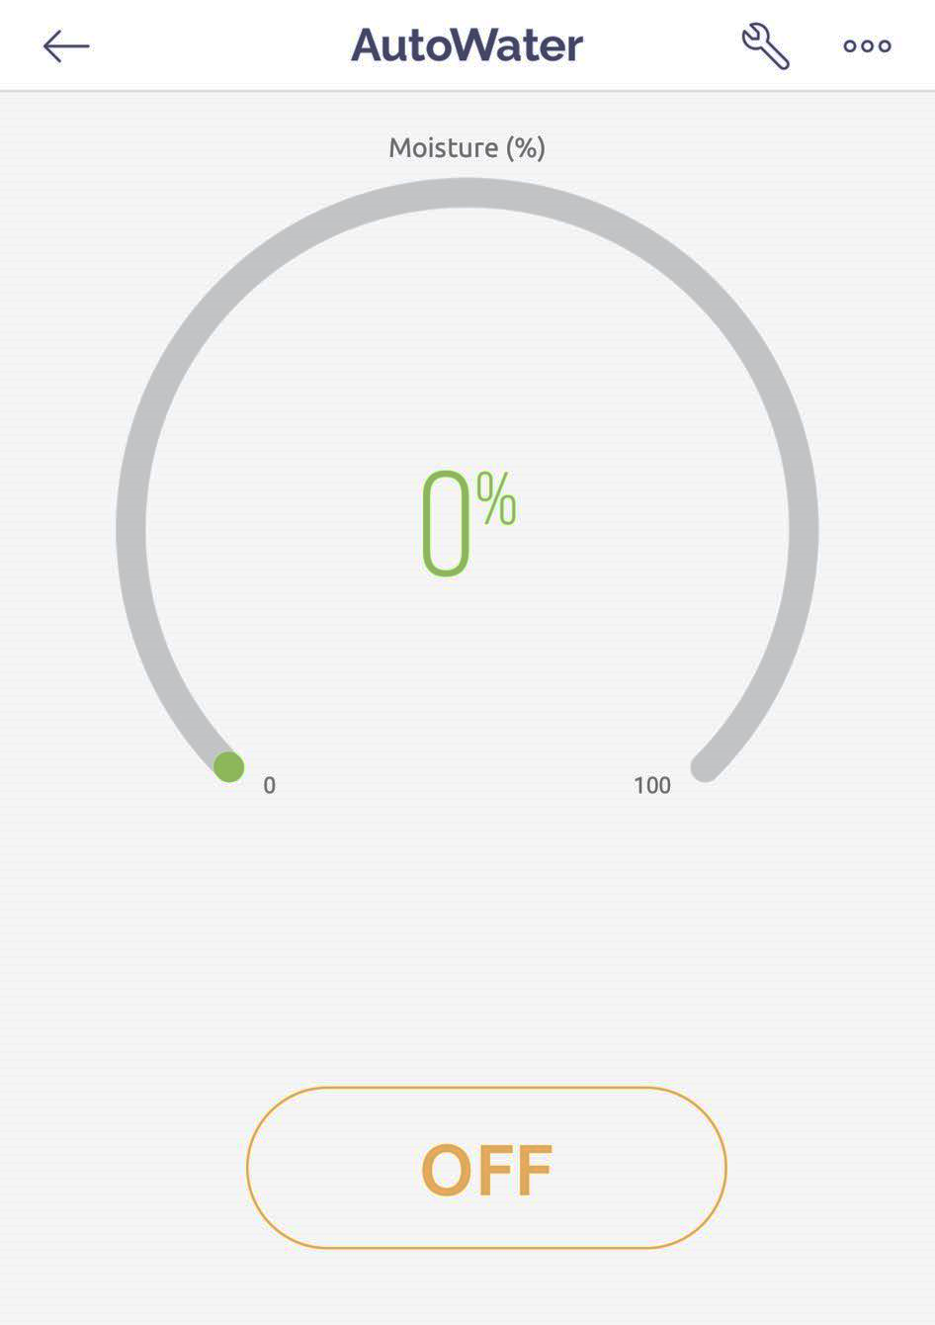
MOBILE APP
Moisture value
Button to control the water pump

Slide 5
DEMO

